Slide 1

CAR RENTAL SYSTEM
GROUP 6
CHANDRA MANOHAR REDDY KUSAM
MAHATHI BANDARI
ASHKA ASHANI
SANDEEP CHINTHALA
HARSHITH CHARUGULLA

Slide 2

ABOUT CAR RENTAL SYSTEM
A car rental is a vehicle that can be used temporarily for a fee during a specified period. Getting a rental car helps people get around despite the fact they do not have access to their own personal vehicle or don't own one. Those who want to rent a car must contact the car rental company.

Slide 3
MOTIVATION
Increasing Demand: As the travel and tourist sector expands, there is an increase in demand for automobile rentals. Customers may be able to rent automobiles in an easy and effective way using a car rental system.
Revenue Generation: Rental fees and services like gasoline are ways that a vehicle rental system might make money. The system may also offer clients the chance to upgrade to a higher-end car or other upselling options.

Slide 4
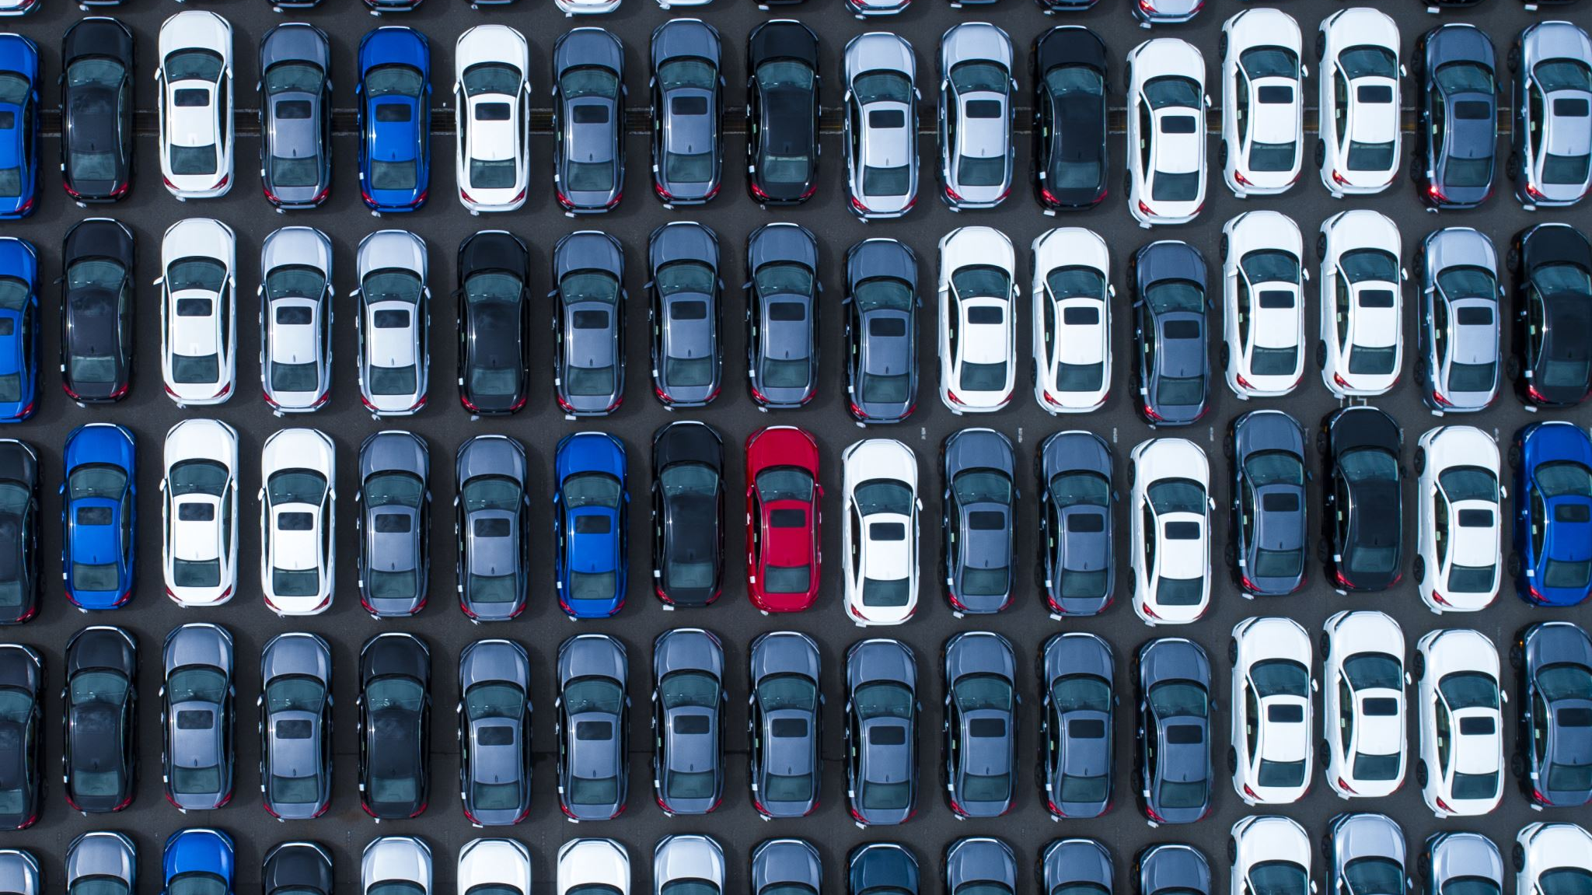
IDEA To produce a web-based system that allows the customer to register and reserve a car online and for the company to effectively manage its car rental business To ease customers to rent a car whenever required.

Slide 5
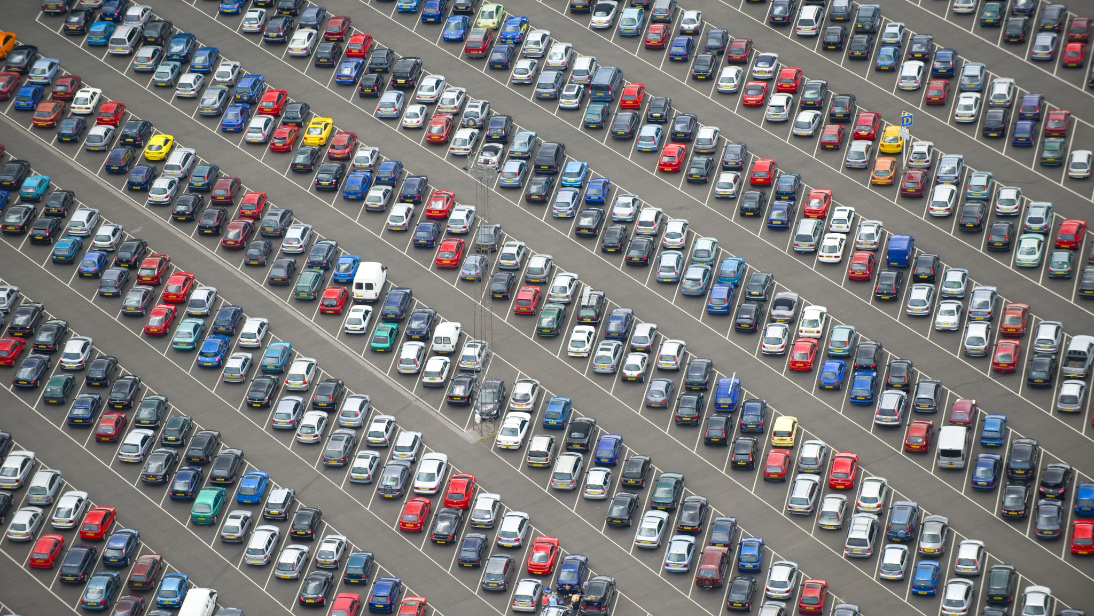
PROJECT USERS AND THEIR NEEDS Users of car rental services may be roughly divided into two groups: Car owners Customer/ Renter Administrators/ Management Customers use the Car rental system for the following needs: Availability of Cars Reservation and Booking Offering car for rent

Slide 6
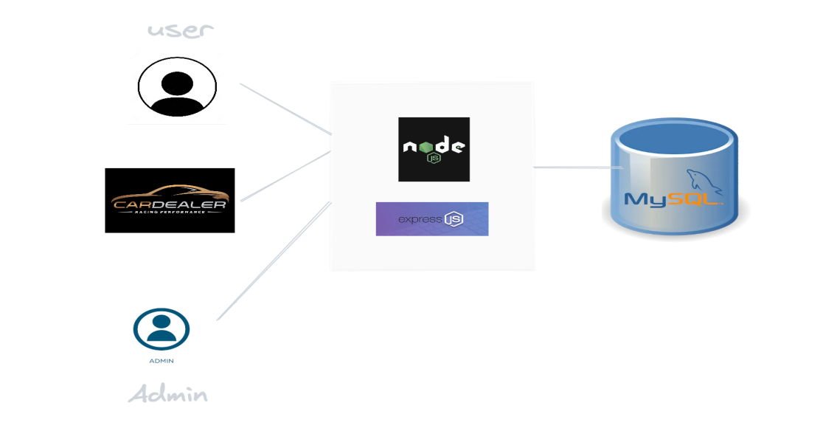
DOMAIN & TECHNOLOGIES This project comes under Travel and Rental Business Domain. Used the below technologies to build the application: Express.js CSS Node.js MySQL

Slide 7

REQUIREMENTS

Slide 8

FUNCTIONAL REQUIREMENTS Customer registration: The system should allow new users to register online and generate membership cards. Online reservation of cars: Customers should be able to use the system to make bookings and online reservations. Automatic update to the database once a reservation is made or a new customer is registered.

Slide 9

NON FUNCTIONAL REQUIREMENTS Ease of use: Considering the level of knowledge possessed by the users of this system, a simple but quality user interface should develop to make it easy to understand and required less training. Availability: This system should always be available for access at 24 hours, 7 days a week. Also, in the occurrence of any major system malfunctioning, the system should be available in 1 to 2 working days, so that the business process is not severely affected.

Slide 10

USER STORIES – CUSTOMERS
Create a user portal where customers will be able to:
Register a car
Upload and Validate driver’s license.
Create a car owner portal where customers will be able to:
Offer a car for rent
Upload car documents, a car title card
As a customer, I want to see all the available options for renting a car.
As a customer, I want to be able to pick up and return the car at a time that works for me, so I can organize my rental around my schedule.

Slide 11

USER STORIES - ADMINISTRATOR
As an administrator, I want to be able to:
Have a homepage that has license request and car legal documentation options
On getting to the license request page, display the approval options for licenses
On the Car legal documentation page, show the car legal paperwork.

Slide 12
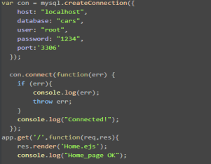
Code Snippet of DataBase Connection

Slide 13
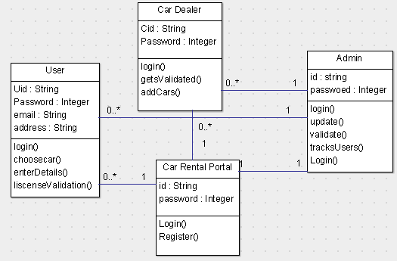
Class Diagram

Slide 14
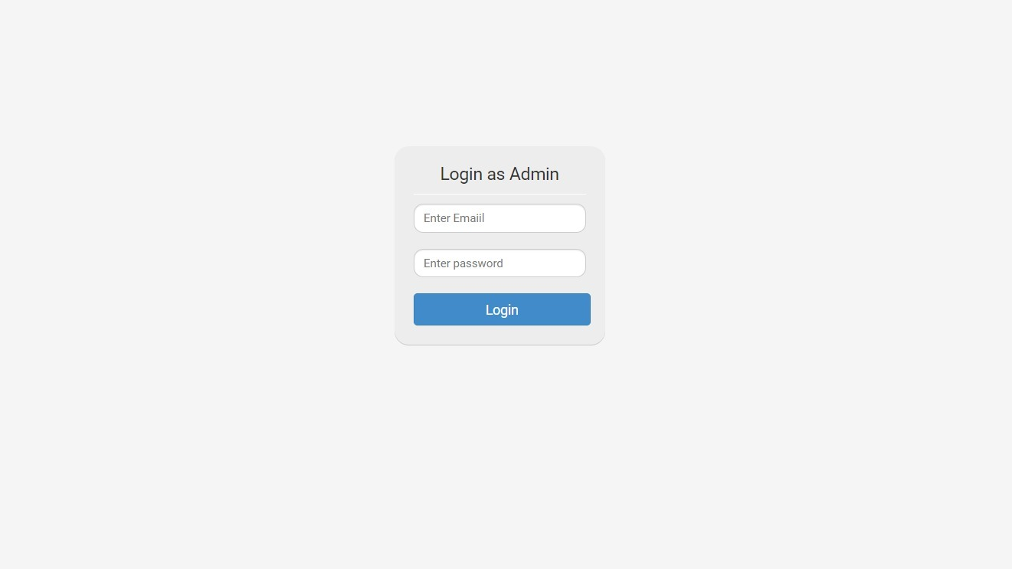
Login Page for Admin

Slide 15
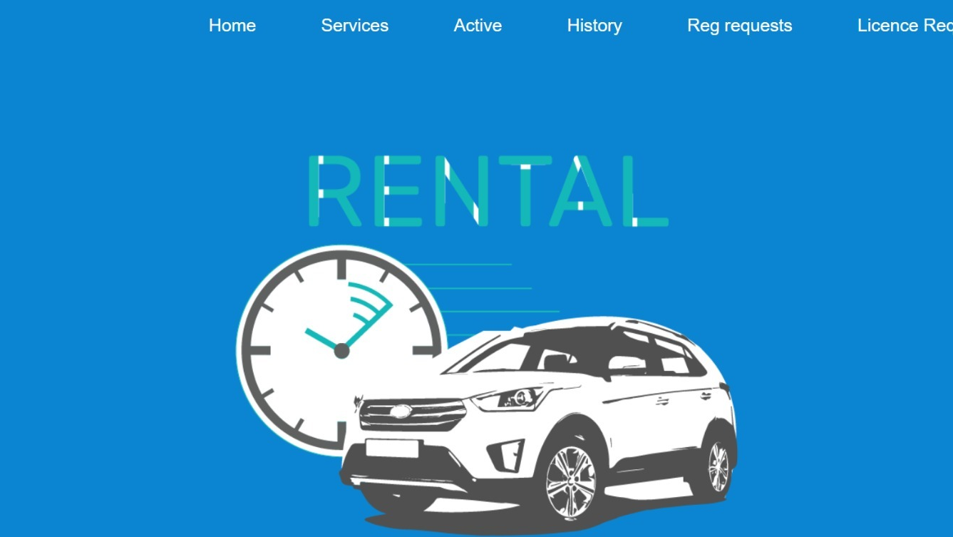
Admin Home Page

Slide 16
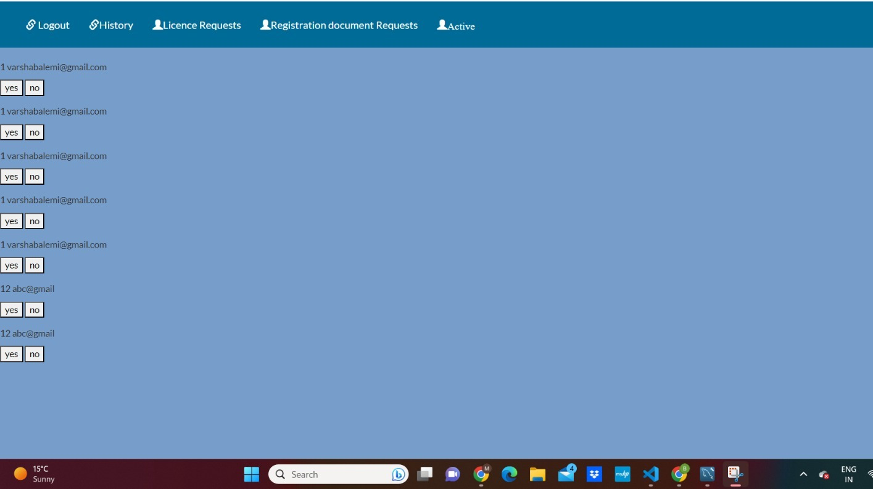
License Requests

Slide 17
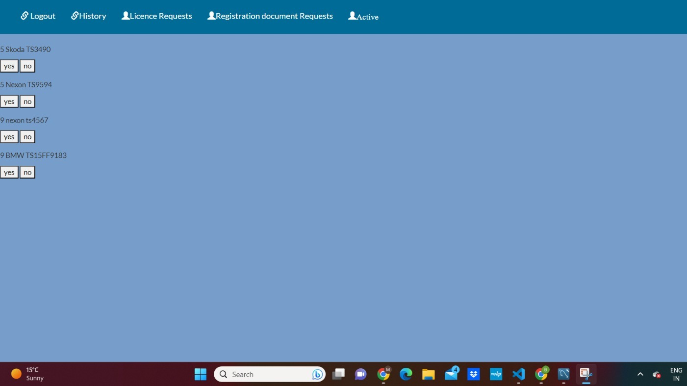
Registration Document Request

Slide 18
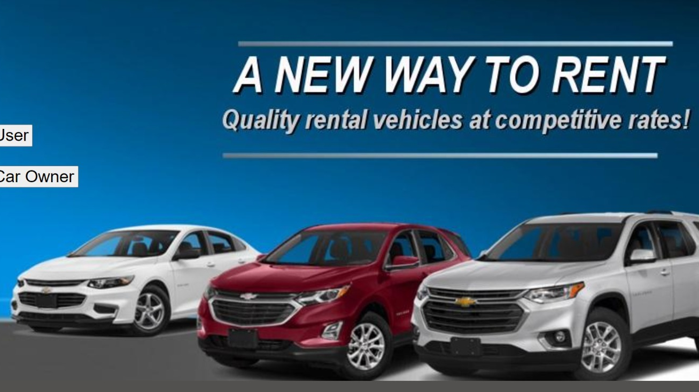
Home Page

Slide 19
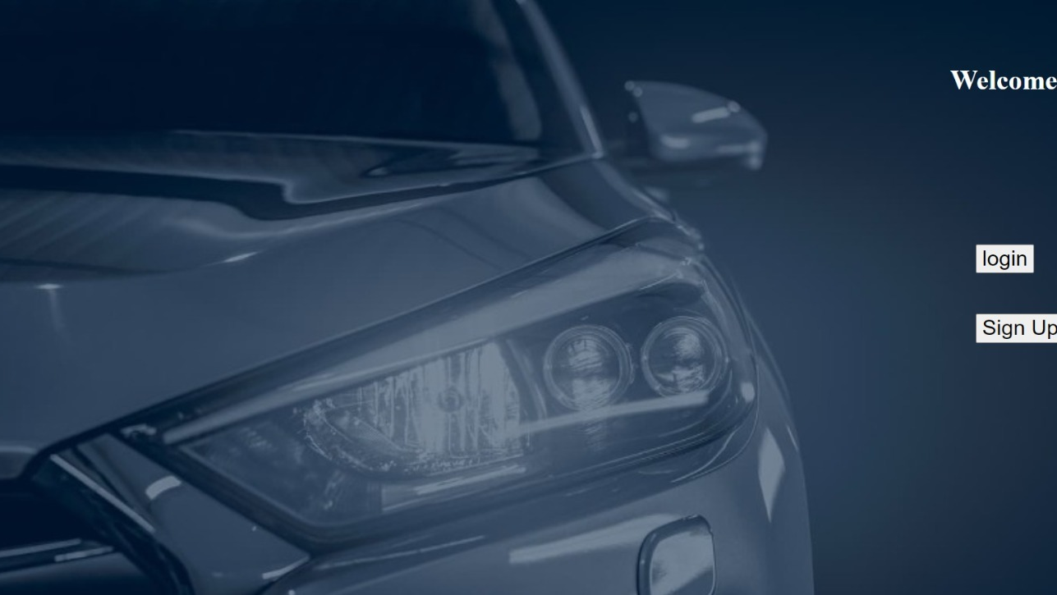
User Login & Signup

Slide 20
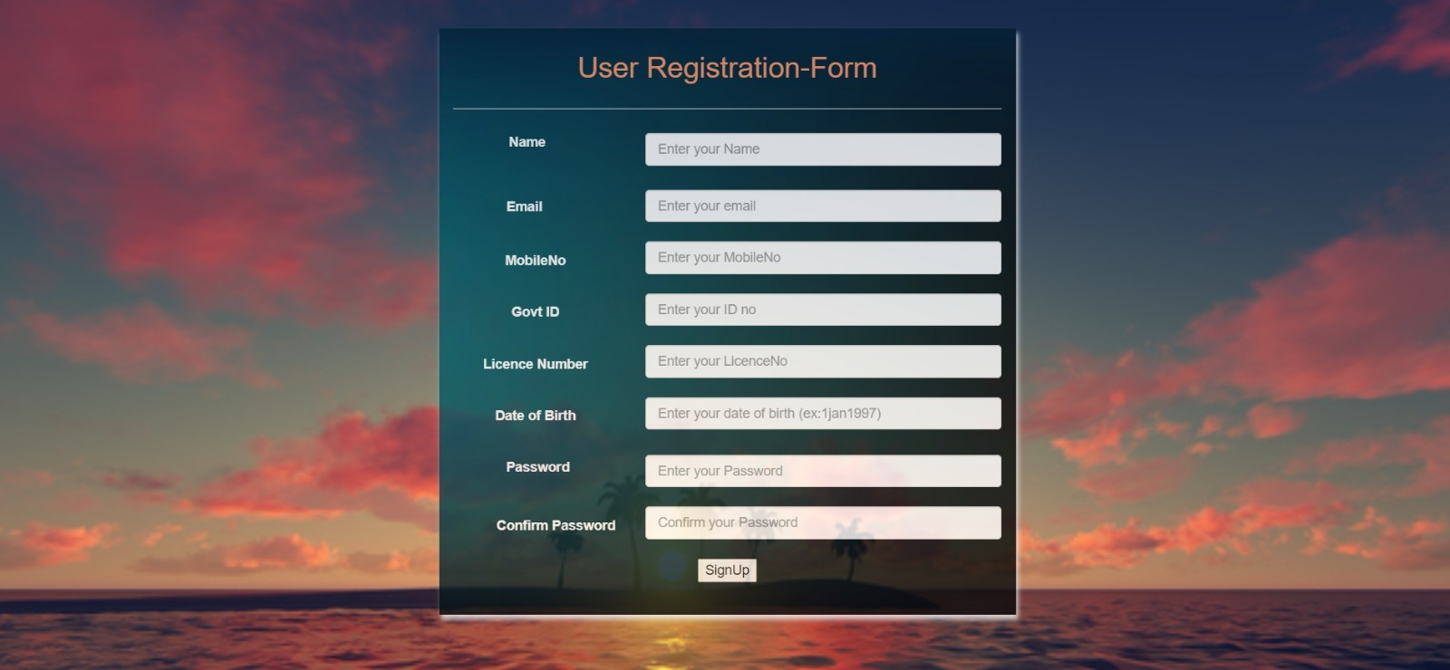
User Signup

Slide 21
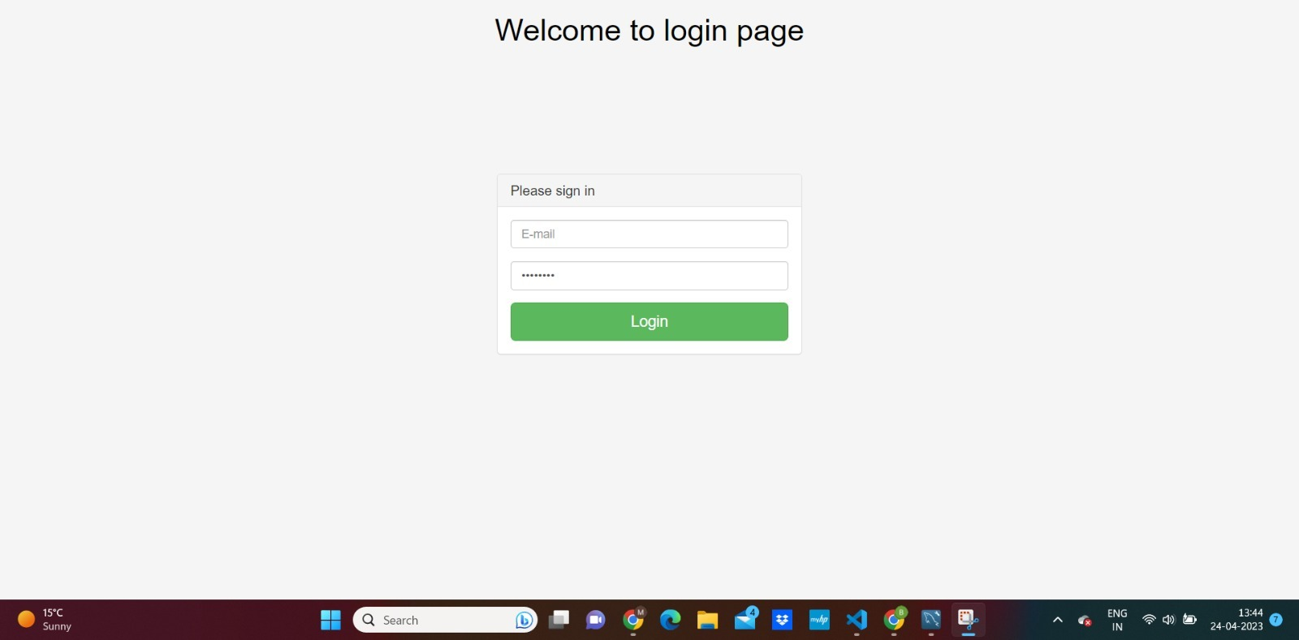
User Login

Slide 22
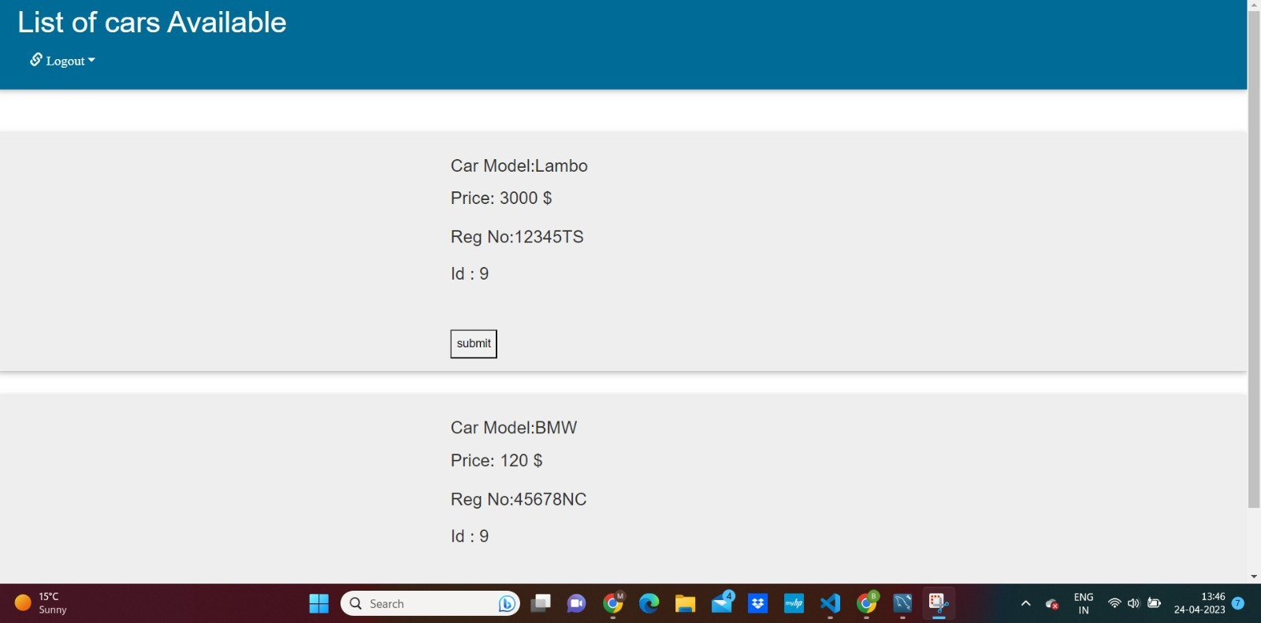
List of Cars Available for User

Slide 23
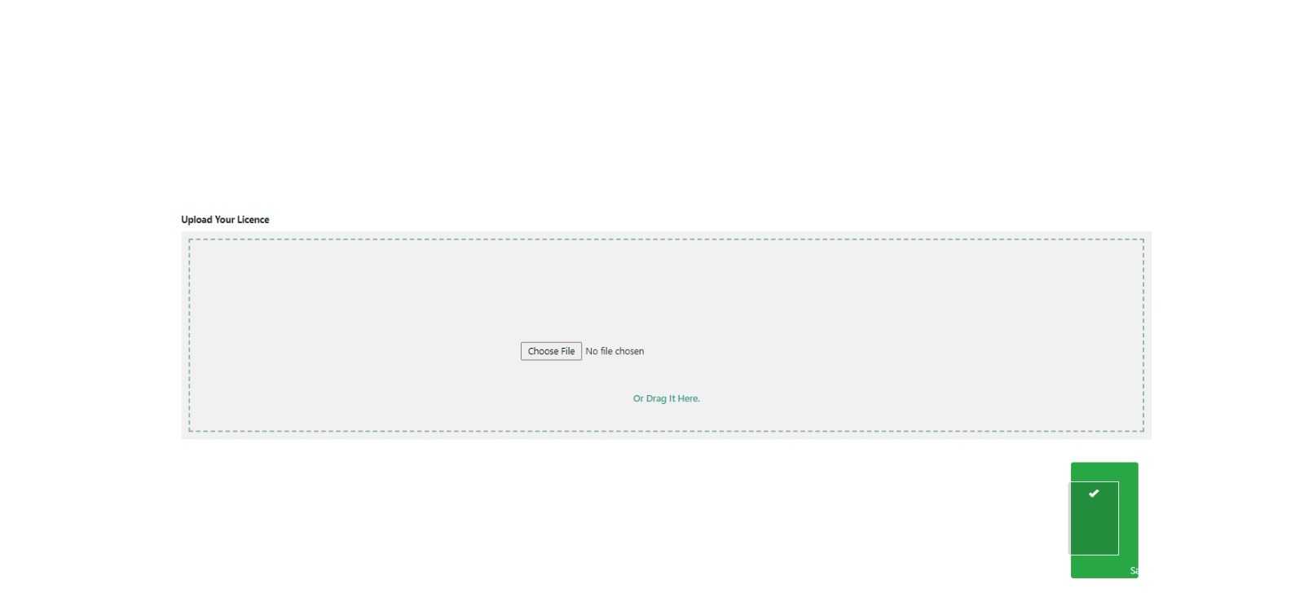
User License Upload

Slide 24
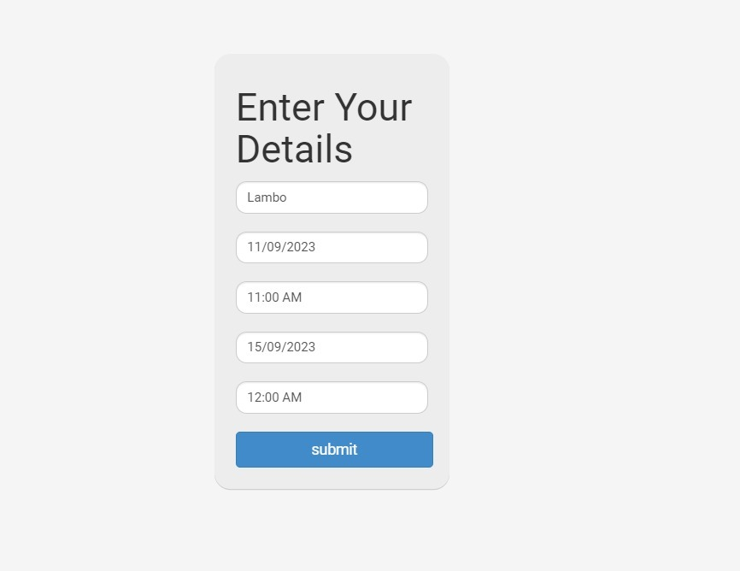
User Booking Details

Slide 25
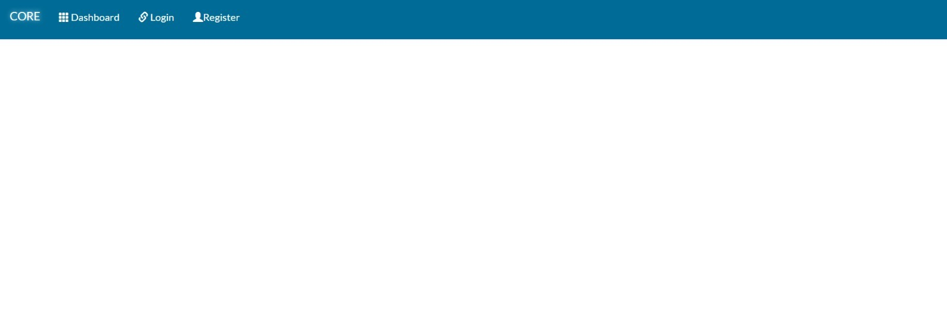
Car Owner Home Page

Slide 26
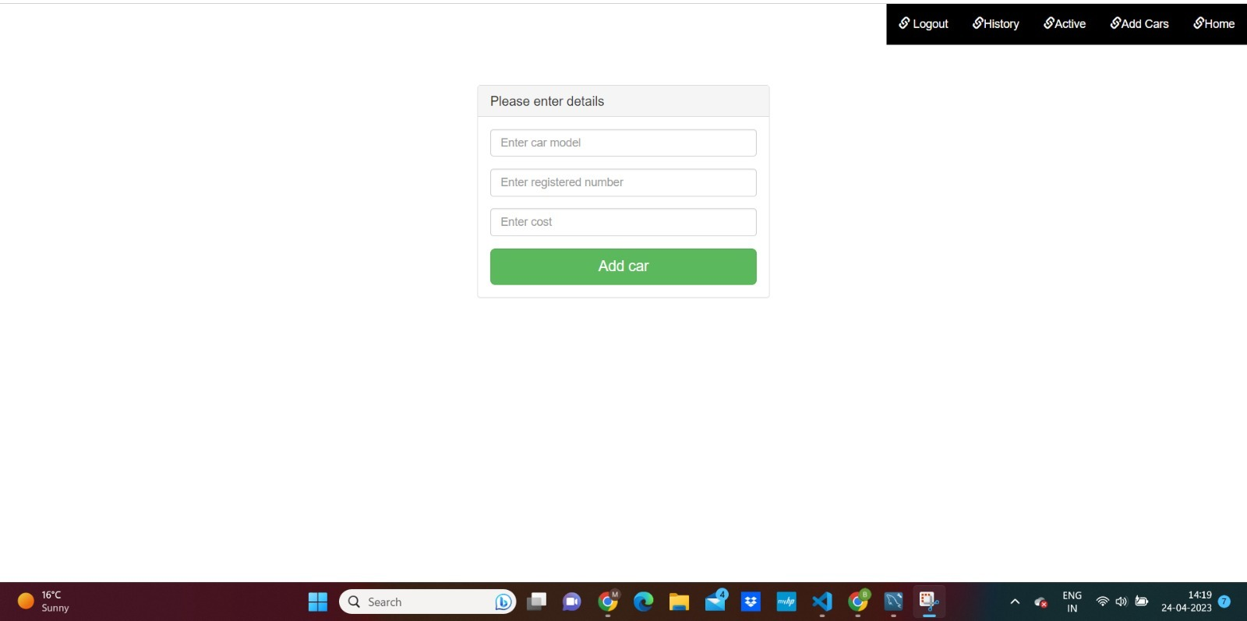
Add Car

Slide 27
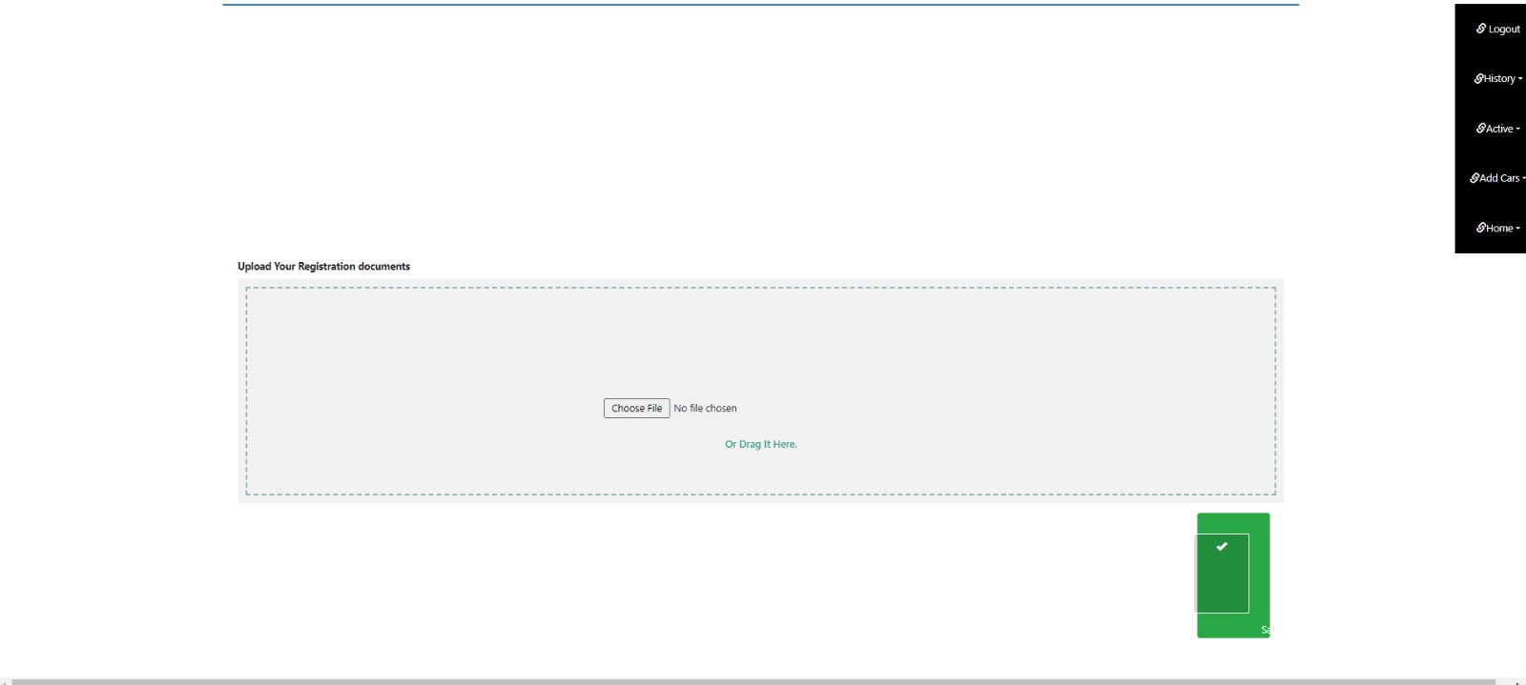
Registration Document

Slide 28

KEY LEARNINGS Validation is required for documents before approval by admin. Car securities should be checked. Customers may have specific needs or preferences, so providing customizable options can improve their experience. Be open to feedback and ideas from other team members. Different perspectives can lead to creative solutions.

Slide 29

FUTURE ENHANCEMENTS Keeping the above things into consideration our application's next update would be regarding the payments section and user interface. Adding to that admin can keep track of his users, and their location. This will be the next update. There will be further updates in the future.

Slide 30

CONCLUSION Our aim is to provide a user-friendly car rental system who want to take a car for rent which overcomes the problem faced using the manual way. The web-based car rental system has offered an advantage to both customers as well as Car Rental Companies to effectively and efficiently manage the business and satisfy customers.

Slide 31

Thank you

